Slide 1
Virtualized Security Service Chains in OpenStack Layer 2
Hands On Lab
SUSECON 2017
John P Studarus Cyber Security & Cloud Consultant, JHL Consulting @John_Studarus John@JHLConsulting.com OpenStack San Diego @OpenStackSD John@OpenStackSanDiego.org

Slide 2
Agenda
Why is Cloud Security so Difficult?
Cloud Security Goals
Service Chaining & Security Function Overview
Lab Environment
OpenStack Cloud Setup
Virtualized Security Functions
Using the Lab
Setting up Service Chains
Configuring Virtualized Security Functions

Slide 3
Why is Cloud Security so Difficult?

Slide 4
Securing Virtualized Workloads
Dynamic Lifetimes
Configuration Complexity
Workloads start/stop randomly
VM lifetimes are short
Contain lifetimes are shorter!
Too fast for manual security
Solution
Dynamically deploy security
Spin up/down with workloads
Workloads have differing configs
Layer 3 networking complexity
Traditionally ‘bolt-on” outside cloud
Solution
Deploy at Layer 2
Service Chain
Utilize pre-built security functions

Slide 5
What is Service Chaining?
Replacing a physical server/appliance that provided network services with a virtual machine/container or within the cloud management layer
Routing
Switching
DHCP
Network Logging
Network Address Translation (NAT)
Floating IPs
Virtual Private Network (VPN)
Network Visualization

Slide 6
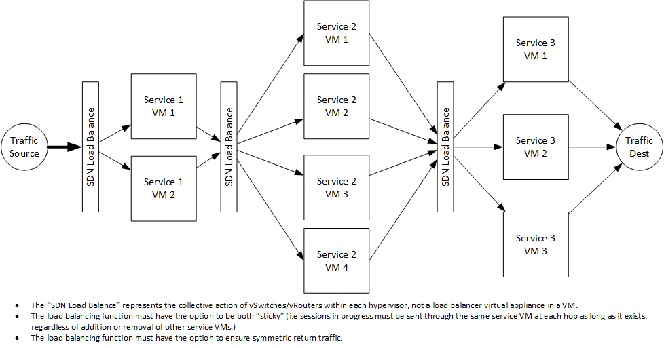
Load Balance Service Chain
Multiple redundant virtual services in a load balanced service chain

Slide 7
Layer 2 versus Layer 3 Service Chaining
Deploying security within layer 2 has multiple advantages over layer 3.
Layer 2 (Datalink)
Layer 3 (IP)
Virtual port assignments
Lower latency
Can filter by IP & TCP/UDP port
Requires SDN support
Invisible to layer 3
Transparent to O.S./Applications
Swap w/o changes to workloads
IP address assignments
Additional network overhead
No layer 2 filtering
No special SDN support required
Visible to layer 3 probes
Invisible to O.S./Applications
Changes required workload reconfig

Slide 8



Which security functions can I virtualize?
Anything you can fit into a VM or Container!
DHCP
Firewall {pfSense}
Anti-DDoS
WAF {modSecurity}
Web Proxy/Filter {squidGuard}
Bot Detection
Database Firewall
IDS/IPS {Snort}
VPN
Tap {TCPDump}

Slide 9
Lab Environment – OpenStack Setup

Slide 10
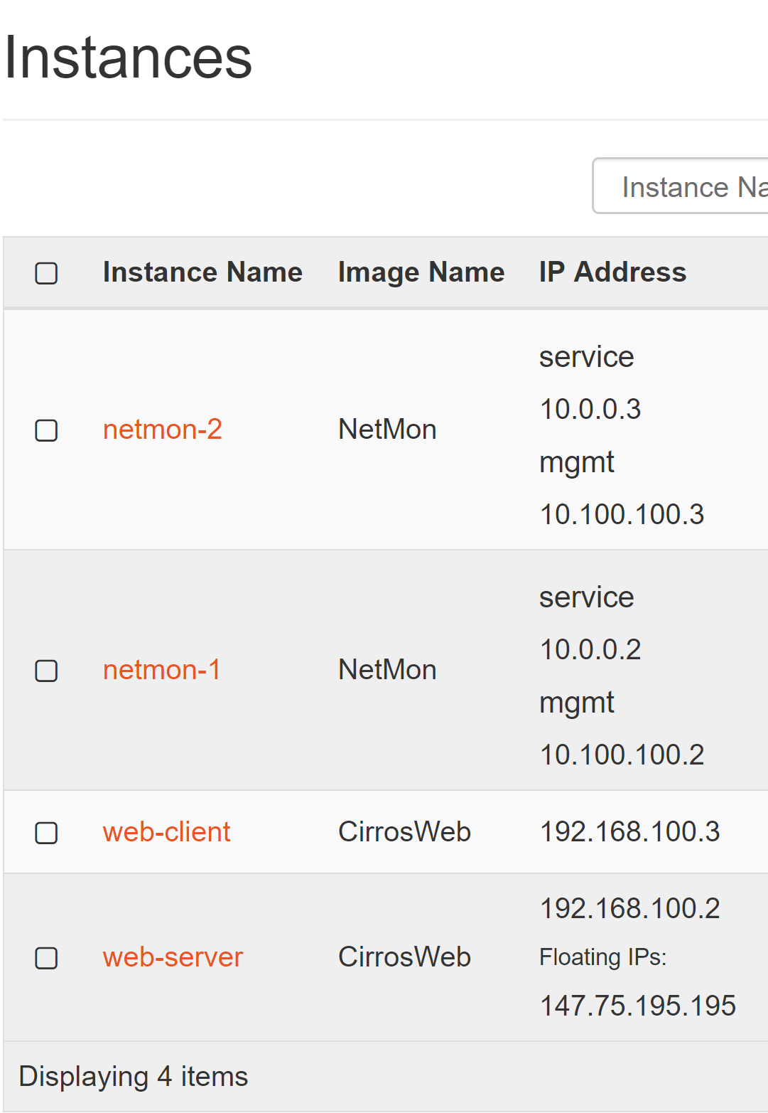
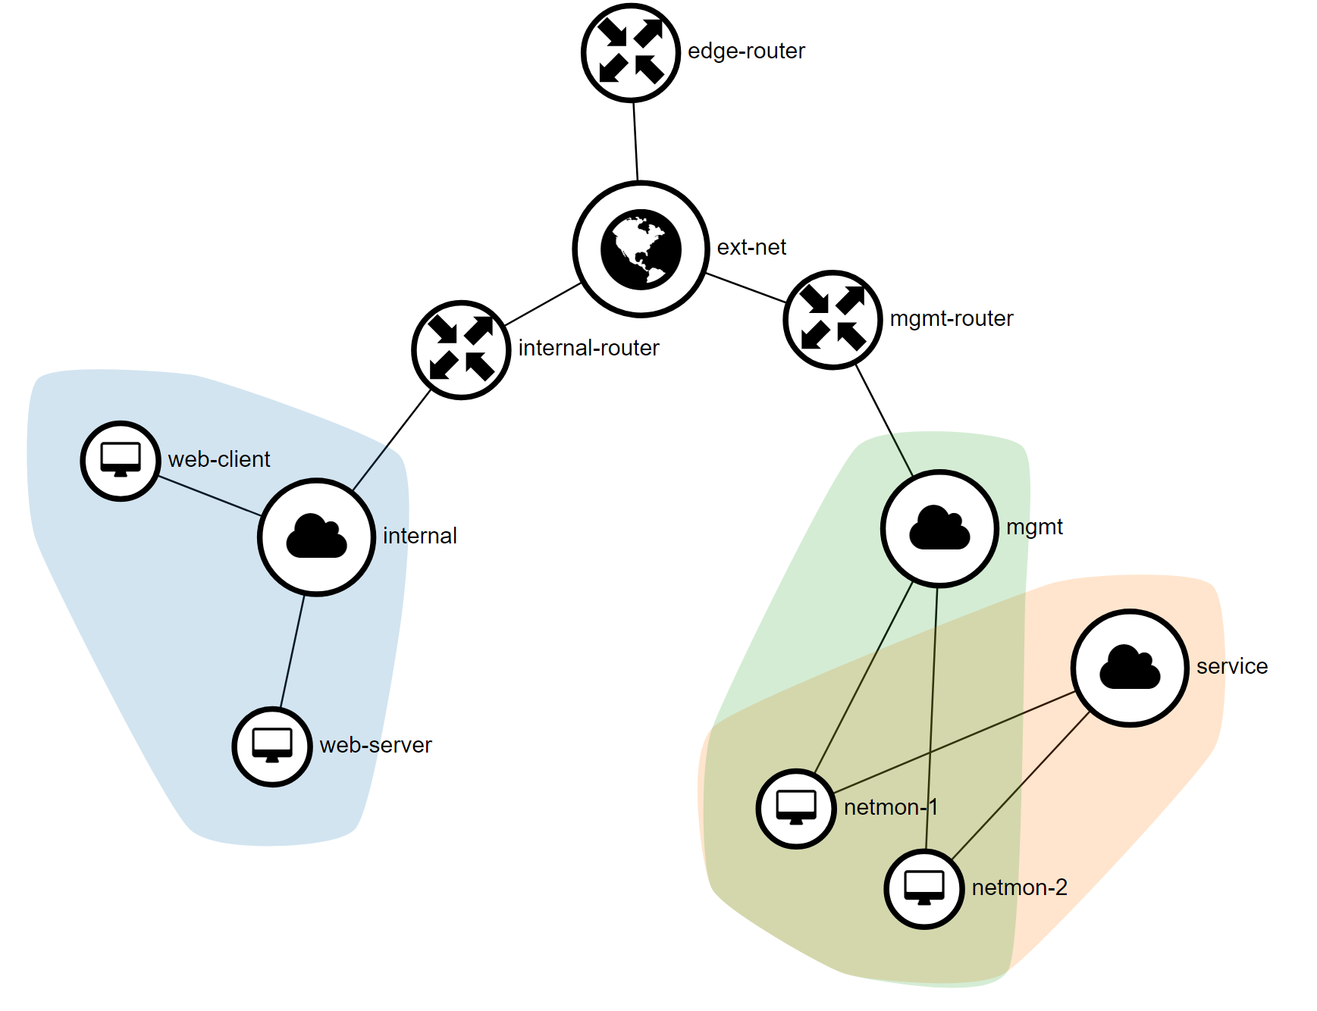
Deployed Workloads and Networks
Layer 3 View of Virtualized Security Functions
Mgmt Network
SSH access
Access to Services
Service Network
Monitoring Ports
Internal
Production Traffic
NetMon-{1,2}
Virtualized Sec Functions

Slide 11
Lab Resources
Access to preconfigured OpenStack Cloud
OpenStack Cloud
Ocata powered OpenStack cloud
network-sfc plugin and CLI enabled
Horizon GUI and OpenStack CLI enabled
Virtualized Security Functions – NetMon
Tcpdump, Snort, and WAF functions available
Defined Networks
Mgmt, Service, and Internal virtual networks pre-configured
External networking enabled with public IPs

Slide 12
Lab Access & Instructions
Please see handout with your specific lab details (IP, password, etc)
Horizon GUI: http:<YOUR_LAB_IP>
Horizon GUI ID: admin
Password: assigned on handout
SSH IP: <YOUR_LAB_IP>
SSH ID: openstack
SSH Password: assigned on handout

Slide 13
Running the Lab – Using Network-SFC

Slide 14
Lab One – Single Security Function
Deploy Basic Service Chain
Goal:
Monitoring traffic to “Web Server” virtual machine
Deploy a basic service chain
Configure NetMon with tcpdump to monitor traffic
Requirements:
Mgmt Network
Service Network
“Web Server” virtual machine
“NetMon” virtual machine
https://github.com/OpenStackSanDiego/SecurityServiceChains/blob/master/Lab1.md

Slide 15
Lab One Layouts
Layer 2 Service Chain
Layer 3 Network Layout
Ports: ingress-1, egress-1
Service L3 Network
Port: ingress-1
Port: egress-1
WebClient
NetMon1
WebServer
WebClient
NetMon
WebServer
Management L3 Network
Internet

Slide 16
Lab Two – Chained Security Functions
Expand to include additional virtual security functions
Goal:
Monitoring and block traffic to “Web Server” virtual machine
Deploy a service chain with two functions (tcpdump and snort)
Configure one NetMon instance with tcpdump to monitor traffic
Configure second NetMon instance with snort to block traffic
Requirements:
Mgmt Network
Service Network
“Web Server” virtual machine
“NetMon” virtual machine
https://github.com/OpenStackSanDiego/SecurityServiceChains/blob/master/Lab2.md

Slide 17
Lab Two Layouts
Layer 2 Network Layout
Layer 3 Network Layout
Ports: ingress-1, egress-1, ingress-2, egress-2
Service L3 Network
Port: ingress-1
Port: egress-2
WebClient
NetMon1
NetMon2
WebServer
WebClient
NetMon1
NetMon2
WebServer
Ports: egress-1, ingress-2
Management L3 Network
Internet

Slide 18
Lab Three – Malicious Detection and Blocking
Monitor and block malicious traffic from black boxes on the network
Goal:
Deploy service chain to monitoring traffic from black box devices
Deployt service chain to block malicious traffic from black boxes
Utilize the available
Requirements:
Mgmt Network
Service Network
“Web Server” virtual machine
“NetMon” virtual machine
“IoT-malicious” virtual machine
https://github.com/OpenStackSanDiego/SecurityServiceChains/blob/master/Lab3.md

Slide 19
Lab Three Layouts
Layer 2 Network Layout
Layer 3 Network Layout
Ports: ingress-1, egress-1, ingress-2, egress-2
Service L3 Network
Port: ingress-1
Port: egress-2
Management Gateway
NetMon1
NetMon2
WebServer
Malicious IoT
NetMon1
NetMon2
Ports: egress-1, ingress-2
Management L3 Network
Internet

